Slide 1





TEXTBOOK TUTOR
An AI-Powered Interactive Learning Assistant
Presentation By Sravani Pati

Slide 2




PROJect Overview
Transforms traditional textbook learning into an interactive, AI-powered experience
Supports summaries, storytelling, business cases, quizzes, and AI chat
Works with both a curated single-textbook dataset and a multi-book RAG pipeline for uploaded PDFs
Fully deployed using FastAPI (Render) for backend and Streamlit Cloud for the frontend

Slide 3




MOTIVATION
Textbook learning is static and not interactive
Students need guided, personalized support
Earlier Colab prototype worked but was slow and not deployable
Goal: Build a clean, accessible, user-friendly learning platform

Slide 4
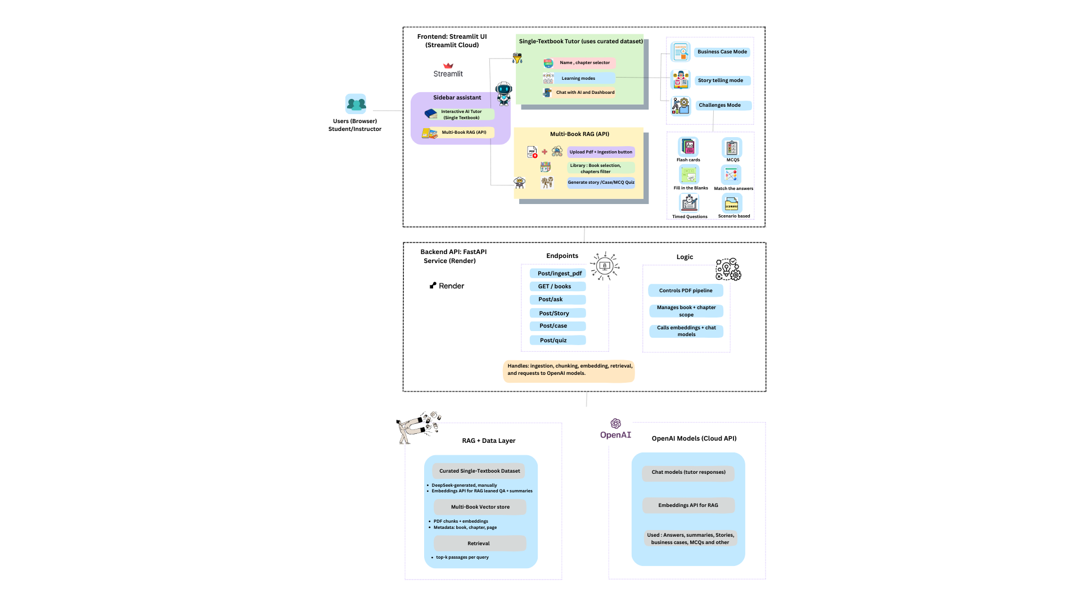
SYSTEM ARCHITECTURE
01
Frontend Interface
Streamlit UI provides an intuitive, responsive interface for seamless user interaction
02
Backend Services
FastAPI deployed on Render handles all AI processing and data management
03
AI Intelligence
OpenAI models power chat interactions and generate embeddings for semantic understanding
04
RAG Pipeline
PDF ingestion → intelligent chunking → embedding generation → contextual retrieval
The system integrates multiple learning modes including summary generation, storytelling, business case development, challenge creation, and conversational Q&A—all orchestrated through a robust, scalable architecture.

Slide 5






RICH FEATURE SET
Interactive AI Tutor
Multi-Book RAG System
Single textbook mode with curated content delivers accurate, contextual learning support tailored to specific educational materials.
Upload and learn from multiple PDFs simultaneously, creating a personalised knowledge base across various subjects.
Diverse Learning Modes
Interactive Challenges
Choose from summary generation, storytelling, business case creation, and more to match your preferred learning style.
Flashcards, MCQs, fill-in-the-blanks, matching exercises, timed questions, and scenario-based learning keep engagement high.
Contextual AI Chat
Progress Tracking
Ask questions and receive intelligent, context-aware responses that deepen understanding of complex topics.
Monitor your learning journey with built-in progress tracking that helps identify strengths and areas for improvement.

Slide 6
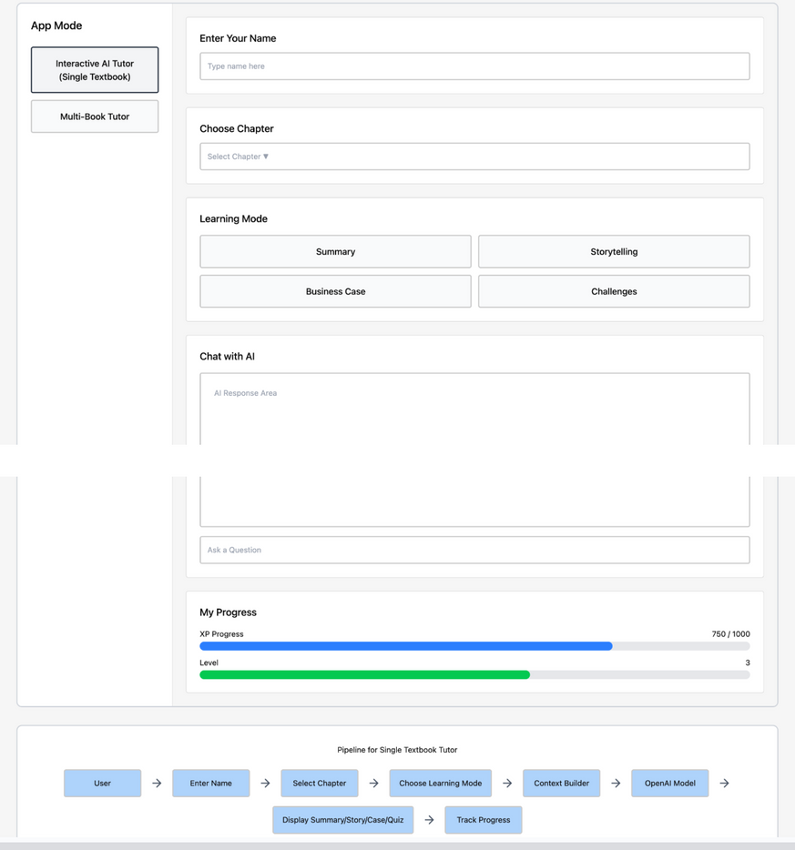

UI/UX DESIGN
The interface was meticulously crafted using Figma Make, progressing from low-fidelity wireframes to high-fidelity prototypes that prioritise user experience.
Sidebar-based navigation for intuitive access to all features
Clean, minimal layout designed around real learning workflows
Responsive design that adapts to different screen sizes
Clear visual hierarchy guiding users through learning journeys
The final implementation closely matches the original wireframes, ensuring consistency between design vision and deployed product.
Fig: Wireframe

Slide 7

DUAL IMPLEMENTATION APPROACH
Single Textbook Tutor
Curated Dataset Approach
Leverages preprocessed summaries and validated Q&A pairs for high accuracy and stable, reliable responses.
Pre-validated educational content
Consistent response quality
Optimised for specific textbooks
Multi-Book Tutor
RAG-Based Flexibility
Dynamic pipeline handling PDF ingestion, intelligent chunking, embedding generation, and contextual retrieval.
Upload any educational PDF
Flexible content processing
Quality varies with source material

Slide 8

DEPLOYMENT JOURNEY
Backend Deployment
1
FastAPI backend deployed on Render with proper environment configuration and secret management for secure API operations.
2
Frontend Deployment
Streamlit web application deployed on Streamlit Cloud, providing accessible interface for users worldwide.
Integration Challenges
3
Resolved backend URL issues and API key errors through careful configuration and separate deployment strategies.
4
Security Implementation
Secrets securely stored in Render and Streamlit Cloud environments, ensuring data protection and API security.
Production Ready
5
Stable, reliable communication between frontend and backend systems delivering seamless user experience.

Slide 9



TESTING & CONTINUOUS REFINEMENT
Validation Through User Feedback
The earlier Colab version underwent extensive testing with 62 participants, providing valuable insights. The new Streamlit version was tested with 5–8 friends for focused feedback.
Clearer Instructions
Step-by-step guidance for PDF upload and content ingestion processes
Improved Layout Spacing
Enhanced visual breathing room for better content readability and reduced cognitive load
Error Messaging
Navigation Flow
Comprehensive status messages and error handling for better user experience
Streamlined navigation and clearer workflow progression throughout the application

Slide 10
OVERCOMING TECHNICAL CHALLENGES
1
2
API Key Management
Deployment Architecture
Challenge: API key errors disrupting service functionality
Challenge: Streamlit Cloud cannot reach localhost, causing communication failures
Solution: Regenerated keys and implemented secure secret management across deployment platforms
Solution: Used Render's public API URL and separated backend/frontend deployments
3
4
Code Portability
RAG Accuracy
Challenge: Colab code not suitable for production deployment
Challenge: Multi-book RAG accuracy varies with different source materials
Solution: Completely rewrote logic specifically for Streamlit architecture and cloud deployment
Solution: Added clearer UI instructions and preprocessing steps to improve content quality
Through iterative problem-solving and architectural refinement, Textbook Tutor evolved into a robust, production-ready learning platform that successfully bridges the gap between traditional textbook learning and modern AI-powered education.

Slide 11
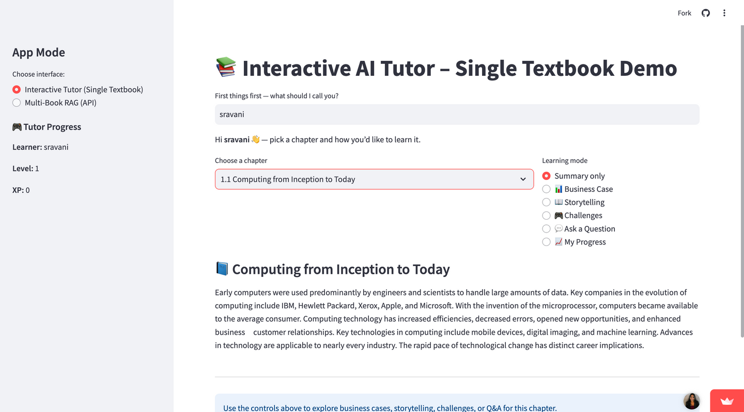




RESULTS
Screenshot of deployed Page
Fully deployed and functional system
Clean, intuitive UI with smooth navigation
Supports both curated textbook learning and multi-book RAG
Faster, easier, and more reliable than the Colab prototype
Positive feedback from users who tested both versions

Slide 12

CONCLUSION
The Textbook Tutor successfully turns static textbook content into an interactive AI learning experience. With a clean Streamlit UI and a FastAPI backend, it now supports both curated chapters and multi-book RAG, offering summaries, stories, business cases, quizzes, and AI chat. The deployed system is simple, fast, and much more usable than the original Colab version, showing that AI-powered textbook learning can be both practical and accessible.

Slide 13

FUTURE WORK
Improve multi-book retrieval accuracy and consistency
Add user accounts and long-term progress tracking
Support more multimedia learning (diagrams, audio, video)
Conduct a larger formal user study
Build analytics dashboards for instructors and learners

Slide 14




THANK YOU

